Slide 1
Home Page
Plant Name
Current photo of plant
New Photo
Soil Moisture Level
Swipe between Views
Sunlight level
Add Plant
Signal Strength
More Info

Slide 2
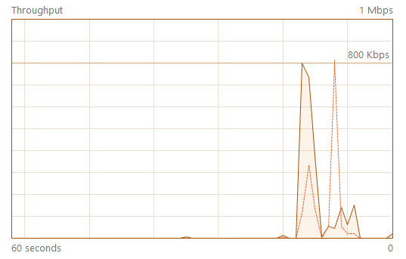
More Info Page
Status
Information
Sensor Status
Moisture Level
Plant Name
IP Address
Test Plant Name
129.xxx.xxx.xxx
Date Planted
Signal Strength
Month, Day, Year
Days Since Planting
99999
Last Watered: XXXX days ago
Water
Light Level
Calibrate Sensors
Connected

Slide 3
Home Page
Plant Waterer Server
Plant Name
Soil Moisture Level
Sunlight level
Signal Strength
More Info

Slide 4
Home Page
Plant Waterer Server
Plant Name
Soil Moisture Level
Sunlight level
Signal Strength
More Info

Slide 5
Home Page
Plant Waterer Server
Plant Name
Soil Moisture Level
Sunlight level
Signal Strength
More Info

Slide 6
Sensor Add Page
Plant Name:
Date Planted:
IP Address:
Photo of Plant:
Add Plant

